Slide 1
Case presentation

Slide 2
Medical history:
Male, 82 yo
161 cm, 85 Kg
Hypertension
Dyslipidimia
DM tipe II
Former Smoker
COPD
CKD IIIb/IV stage (eGRF 32 ml/min)
Previous PCI (LAD and Cx) 2008.
Previous surgical aortic valve replacement (2011). Edwards inspiris resilia.
Anemia
- Currently symptomatic for dyspnea NYAH III

Slide 3
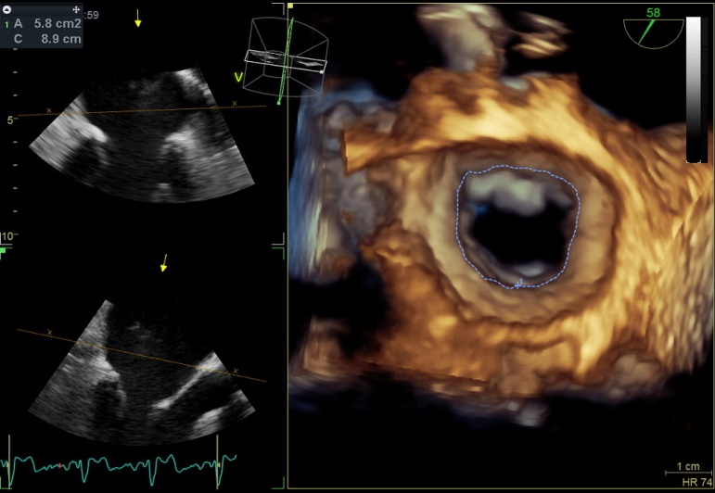
MITRAL VALVE TEE
TRICUSPID VALVE
A1
A2
A3

Slide 4
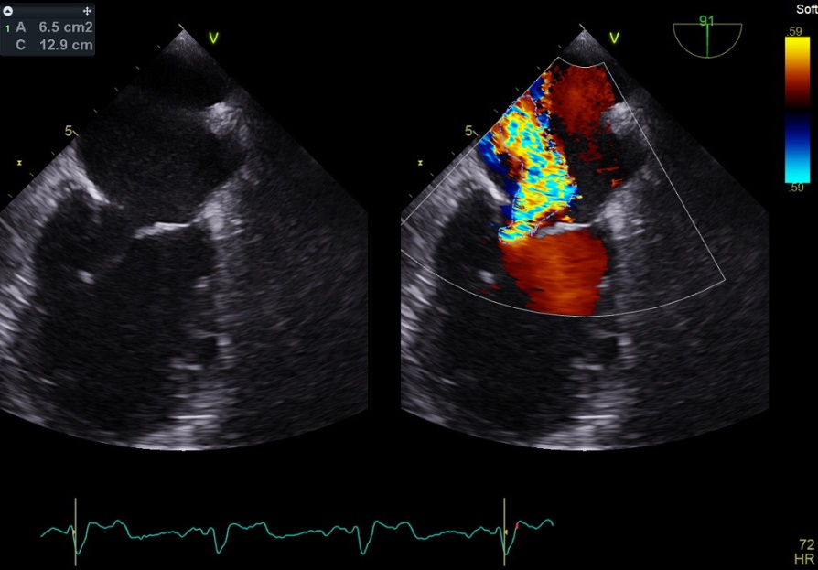
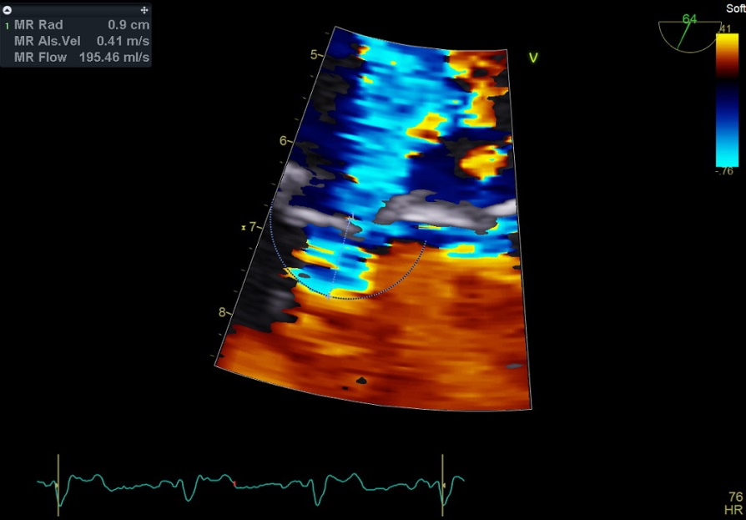
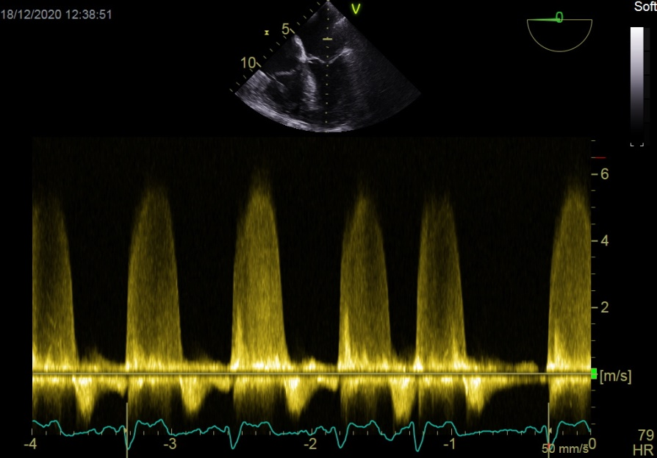
TEE MITRAL VALVE_MEASUREMENTS
- PISA-RAD di 9 mm
60 ml di RV; 5.85 mt/sec
Dagger-Shape alla spettrometria continua.
‘Reverse-flow’ sistolico al Pulsato campionato su vena polmonare superiore destra.
MVA 5,8 cm2

Slide 5
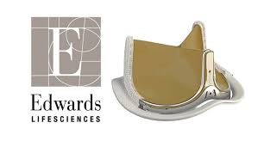
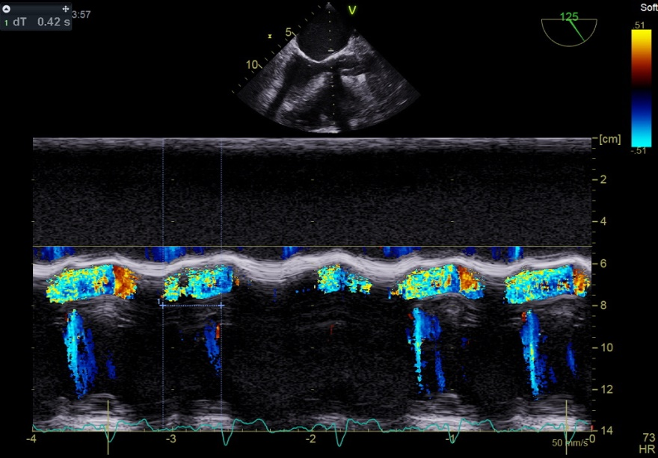
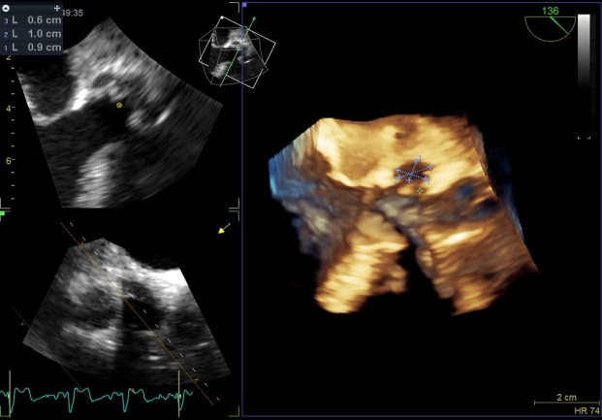
AORTIC VALVE TEE

Slide 6
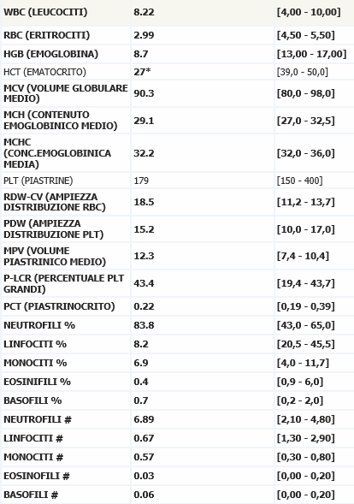
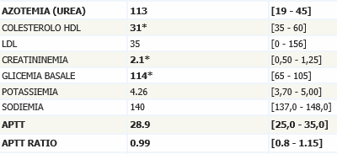
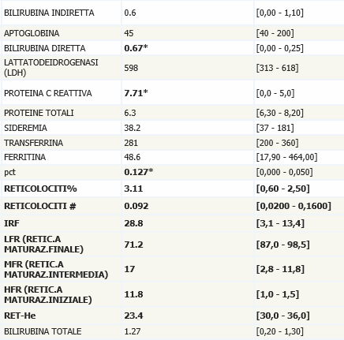
BLOOD WORK AND RISK SCORE
Risk of Mortality: | 13.919%
Renal Failure: | 28.424%
Permanent Stroke: | 8.212%
Prolonged Ventilation: | 22.545%
DSW Infection: | 0.338%
Reoperation: | 6.197%
Morbidity or Mortality: | 43.869%
Short Length of Stay: | 6.918%
Long Length of Stay: | 28.670%
LOGISTIC EUROSCORE: 35%
STS-SCORE

